Slide 1



CONCEPTUAL DESIGN PRESENTATION Devices Trying to Score in Each Others’ Goals 27.12.2018
PITECH

Slide 2

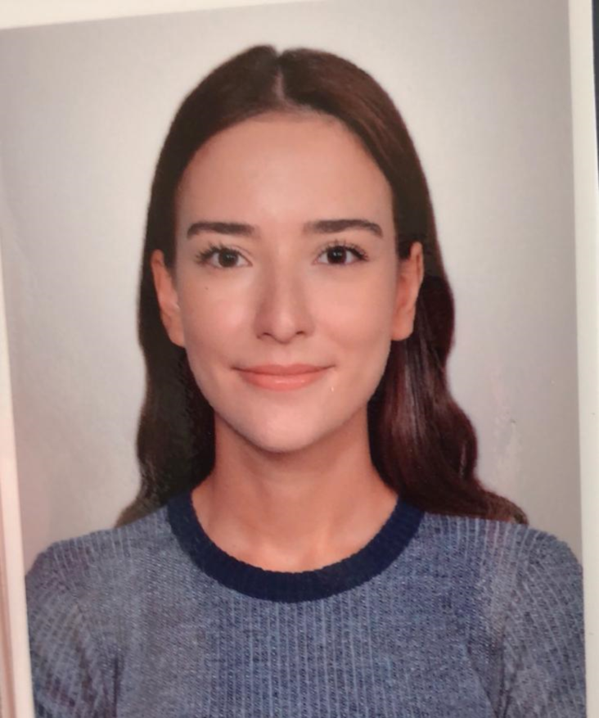
CEO FATMA NUR ARABACI
PITECH

Slide 3
Presentation Outline
01
04
Company Profile
Solution Approaches
02
05
Problem Statement
Plans
03
06
Objectives
Conclusion
PITECH

Slide 4
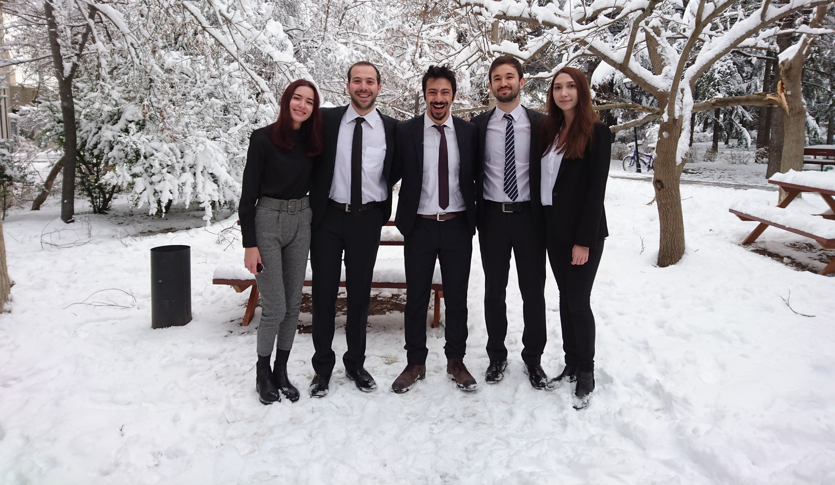
COMPANY PROFILE Shareholders
CEO Fatma Nur ARABACI 2030047 | CMO Berkay GÖKSU 2030757 | CTO Furkan Bahadır ELİK 2030518 | CFO Aycan BEYENİR 2030328 | COO İrem COŞKUN 2030419
PITECH

Slide 5
COMPANY PROFILE Mission & Vision
Mission
To provide creative and reliable solutions that fulfill the needs of industry in the field of Industrial robot applications.
Vision
To become the most compelling technology company by driving the industry’s transition to smart manufacturing.
PITECH

Slide 6
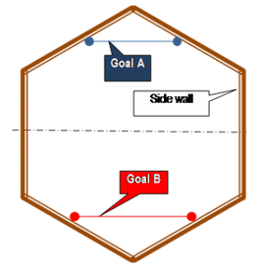
PROBLEM STATEMENT
Try to score in the opponents’ goal
Try to defend our own goal
Control via tele-operator (non-autonomous)
~75 cm
PITECH

Slide 7
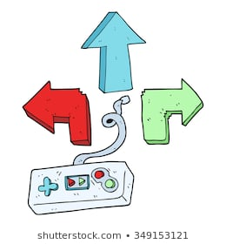
Oppenents’ Goal
Opponents’ Robot
The ball
Half Field Line
Our Goal
>= 30 m
Controller Side
Our Robot
Robot Side
PITECH

Slide 8
PROBLEM STATEMENT Requirements & Constraints
Oppenents’ Goal
Goal line should be two times of our robots’ diameter
20 sec restriction
Robot should stay in its’ half field
Carrying, grasping and scooping the ball is not allowed.
Within $200 budget
Half Field Line
Our Goal
PITECH

Slide 9
OBJECTIVES Performance Related Objectives
Power Consumption
Transmission Delay
Range
Perfect–>more than 30m indoor
Sufficient-> 30 m indoor
Poor/Failure-> less than 30 m indoor
Perfect–> 30 min of operation
Sufficient -> 15 min of operation
Poor -> 5 min of operation
Perfect–> 100 ms delay
Good -> 400 ms delay
Sufficient-> 600 ms delay
Poor-> 1 sec delay
PITECH

Slide 10
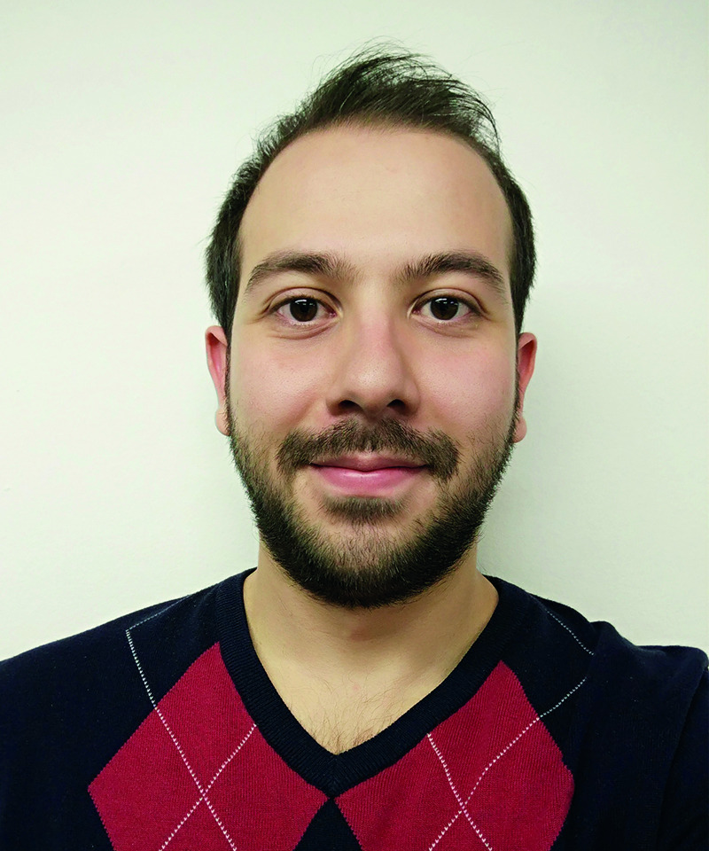
CMO BERKAY GÖKSU
PITECH

Slide 11

Overall Block Diagram Flow Chart Shooting Subsystem Motion Subsystem
PITECH

Slide 12
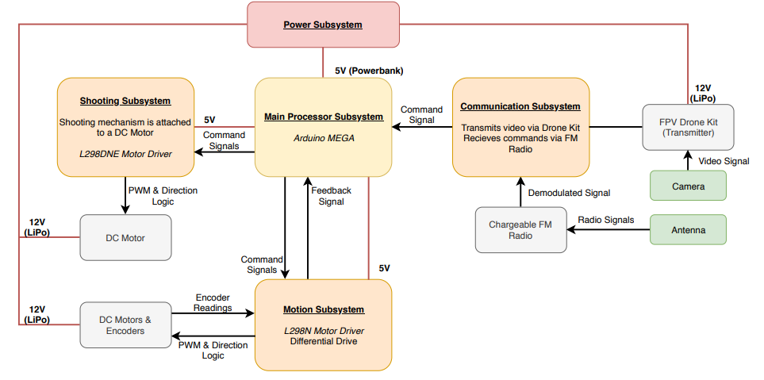
Block Diagram of Robot Side
PITECH

Slide 13
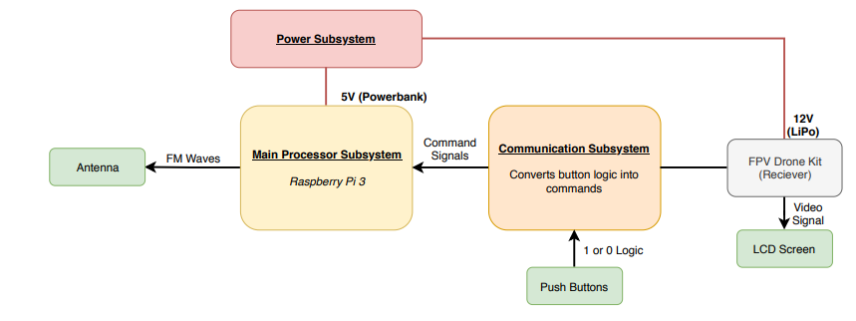
Block Diagram of Controller Side
PITECH

Slide 14
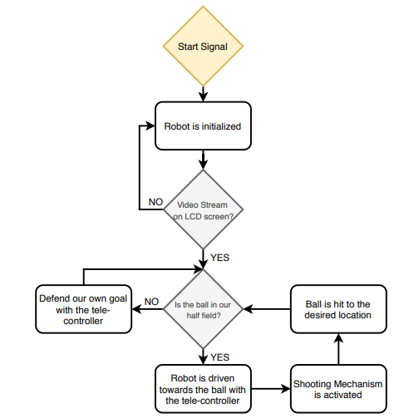
Flow Chart
PITECH

Slide 15
SUBSYSTEMS
Shooting Subsystem
Motion Subsystem
Communication Subsystem
Power Supply Subsystem
Main Processor Subsystem
PITECH

Slide 16

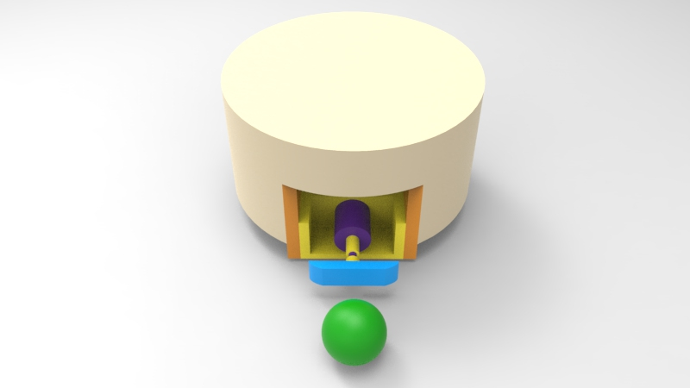
Shooting Subsystem
PITECH

Slide 17
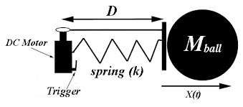
Spring actuated
Very powerful, much energy can be stored
Simple mechanism (wound up, held, and released)
PITECH

Slide 18
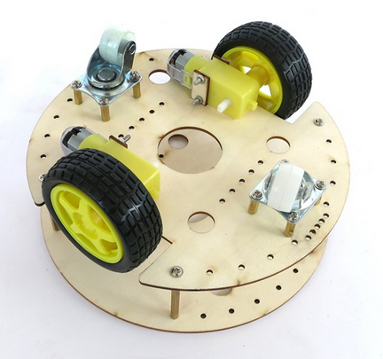
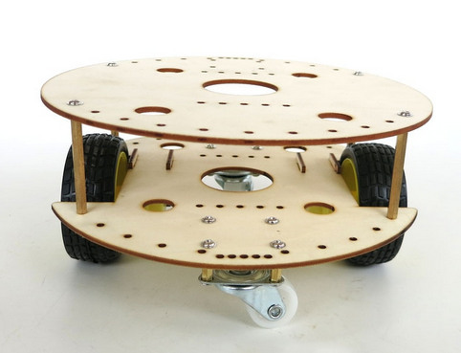
Motion Subsystem
2 DC Motors and encoders & 2 Drive Wheels
2 Caster Wheels
PITECH

Slide 19
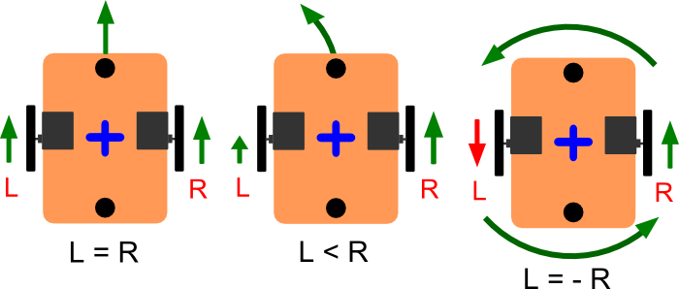
Differential Drive
Easy to program
Well controlled
Simple
Low Cost
PITECH

Slide 20
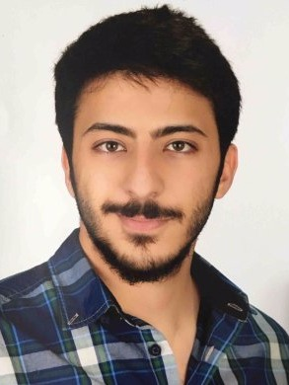
CTO FURKAN BAHADIR ELİK
PITECH

Slide 21
Communication Subsystem Command Transmission
PITECH

Slide 22
Communication Subsystem Command Transmission
FM Radio infrastructure
Frequency shift keying with FM carrier
PITECH

Slide 23
Controller Side
PITECH

Slide 24
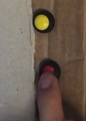
Controller Side
Button Press
PITECH

Slide 25
Controller Side
Button Press
A command is generated
PITECH

Slide 26
Controller Side
Button Press
A command is generated
Raspberry Pi
PITECH

Slide 27
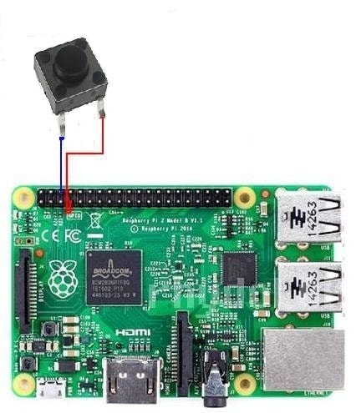
Controller Side
Button Press
A command is generated
Raspberry Pi
The command is received
PITECH

Slide 28
Controller Side
Button Press
A command is generated
Raspberry Pi
The command is received
Program
PITECH

Slide 29
Controller Side
Button Press
A command is generated
Raspberry Pi
The command is received
Received command is interpreted and a sine wave is generated
Program
PITECH

Slide 30

Controller Side
FSK
1st command
2nd command
3rd command
4th command
5th command
f1
f2
f3
f4
f5
Button Press
A command is generated
Raspberry Pi
The command is received
Received command is interpreted and a sine wave is generated
Program
50 Hz < fn < 20 kHz
PITECH

Slide 31
Controller Side
Button Press
A command is generated
Raspberry Pi
The command is received
Received command is interpreted and a sine wave is generated
Program
Program
Generated sine wave is FM modulated with pre-chosen fc
PITECH

Slide 32
Controller Side
Button Press
A command is generated
Raspberry Pi
The command is received
Received command is interpreted and a sine wave is generated
Program
Program
Generated sine wave is FM modulated with pre-chosen fc
87.5 MHz < fc < 108 MHz
PITECH

Slide 33
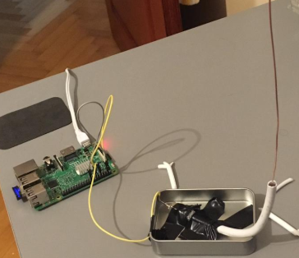
Controller Side
Button Press
A command is generated
Raspberry Pi
The command is received
Received command is interpreted and a sine wave is generated
Program
Program
Generated sine wave is FM modulated with pre-chosen fc
Raspberry Pi
Generated FM modulated signal is fed to an external antenna
PITECH

Slide 34


Controller Side
Button Press
A command is generated
Raspberry Pi
The command is received
Received command is interpreted and a sine wave is generated
Program
Program
Generated sine wave is FM modulated with pre-chosen fc
Raspberry Pi
Generated FM modulated signal is fed to an external antenna
Antenna
Generated FM wave is transmitter to air
PITECH

Slide 35
Robot Side
PITECH

Slide 36
Robot Side
Antenna
PITECH

Slide 37
Robot Side
Antenna
Transmitted FM wave received
PITECH

Slide 38
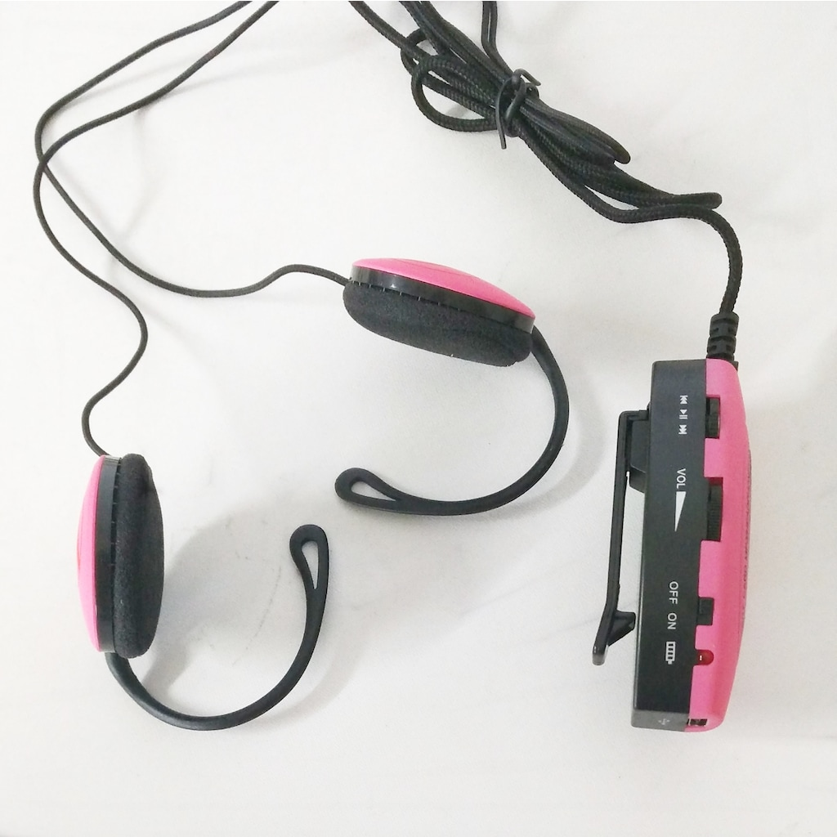
Robot Side
Antenna
Transmitted FM wave received
FM Radio
PITECH

Slide 39
Robot Side
Antenna
Transmitted FM wave received
Received FM wave demodulated and gain controlled
FM Radio
Provides FM demodulation and automatic gain control (AGC)
PITECH

Slide 40
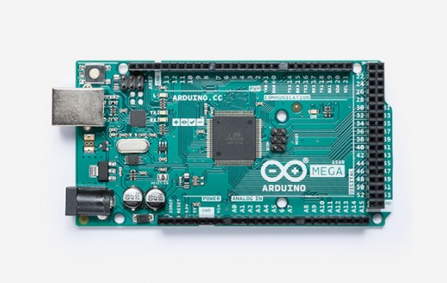
Robot Side
Antenna
Transmitted FM wave received
Received FM wave demodulated and gain controlled
FM Radio
Arduino
PITECH

Slide 41
Robot Side
Antenna
Transmitted FM wave received
Received FM wave demodulated and gain controlled
FM Radio
Arduino
Demodulated FSK signal received
PITECH

Slide 42
Robot Side
Antenna
Transmitted FM wave received
Received FM wave demodulated and gain controlled
FM Radio
Arduino
Demodulated FSK signal received
Program
PITECH

Slide 43
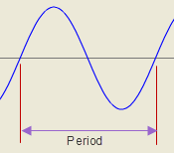
Robot Side
Antenna
Transmitted FM wave received
Received FM wave demodulated and gain controlled
FM Radio
Arduino
Demodulated FSK signal received
Program
FSK signal interpreted and its frequency is obtained
Frequency = 1/Period
PITECH

Slide 44
Robot Side
Antenna
Transmitted FM wave received
Received FM wave demodulated and gain controlled
FM Radio
Arduino
Demodulated FSK signal received
Program
FSK signal interpreted and its frequency is obtained
Program
PITECH

Slide 45
Robot Side
Antenna
Transmitted FM wave received
Received FM wave demodulated and gain controlled
f1
f2
f3
f4
f5
1st command
2nd command
3rd command
4th command
5th command
FM Radio
Arduino
Demodulated FSK signal received
Program
FSK signal interpreted and its frequency is obtained
Program
The command is received based on received frequency
PITECH

Slide 46
Robot Side
Antenna
Transmitted FM wave received
Received FM wave demodulated and gain controlled
FM Radio
Arduino
Demodulated FSK signal received
Program
FSK signal interpreted and its frequency is obtained
Program
The command is received based on received frequency
Program
PITECH

Slide 47
Robot Side
Antenna
Transmitted FM wave received
Received FM wave demodulated and gain controlled
FM Radio
GO AHEAD!
Arduino
Demodulated FSK signal received
Program
FSK signal interpreted and its frequency is obtained
Program
The command is received based on received frequency
Program
The command is executed
PITECH

Slide 48
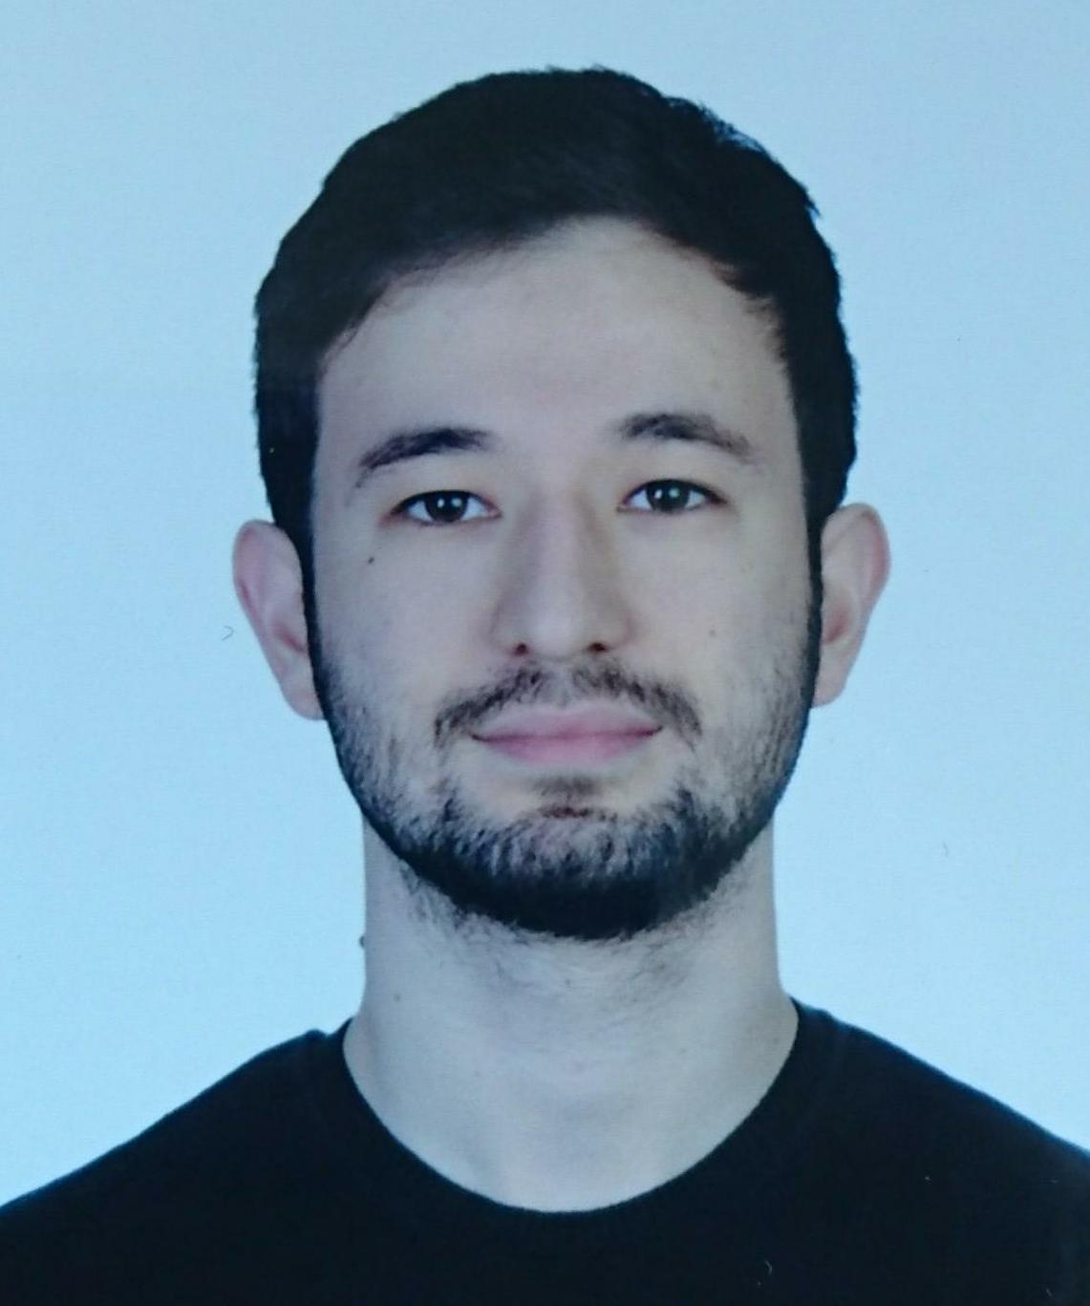
CFO AYCAN BEYENİR
PITECH

Slide 49
Visual Information Transmission Part of Communication Subsystem
Power Supply Subsystem
PITECH

Slide 50
Communication Subsystem: Visual Information Transmission
The system must;
Transfer all necessary information,
Introduce minimum transmission delay,
Provide stable flow of information,
Inexpensive.
PITECH

Slide 51
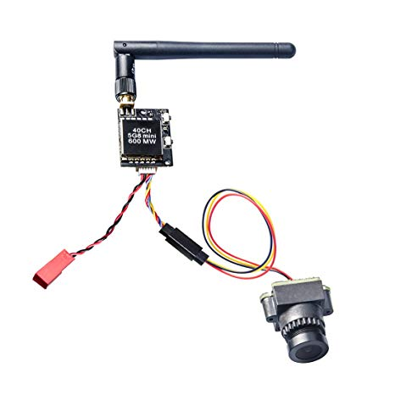
Main Plan
FPV Camera with 600mW transmitter
This module provide;
High quality video acquisition and transmission
Approximately zero delay
Stable video stream over 30+ meter
Low cost
AKK KC03 FPV Camera with 600MW Transmitter (n.d.). Retrieved from https://www.akktek.com/akk-kc03.html
PITECH

Slide 52


Backup Plan
Robot
Telecontroller
Current capture of Camera
Visual
Information Transmitter
Visual
Information Receiver
Screen
Image Processing
Information 1
Visual Rebuilt
Information 2
Information 3
PITECH

Slide 53
Power Subsystem
For best performance this subsystem must:
Provide isolation between subsystems,
Provide 5V and 12V supply,
Lightweight,
Inexpensive.
PITECH

Slide 54
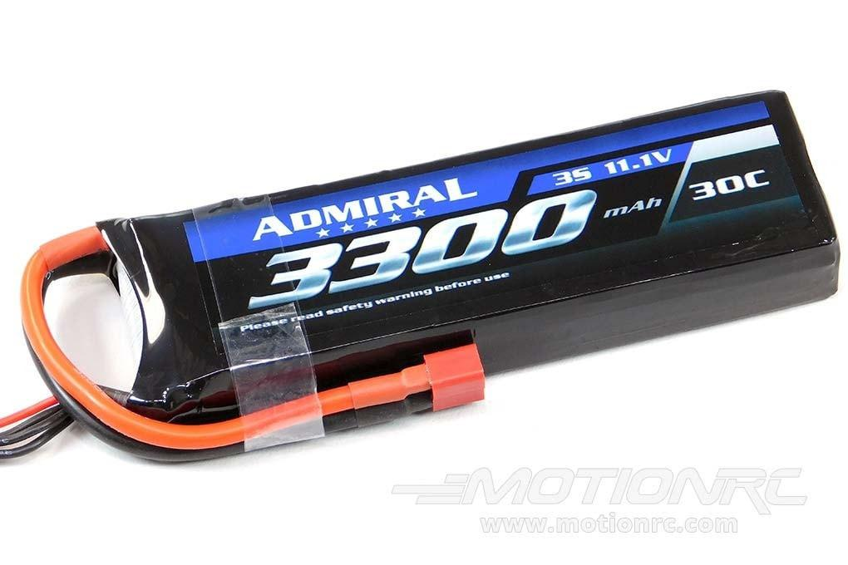
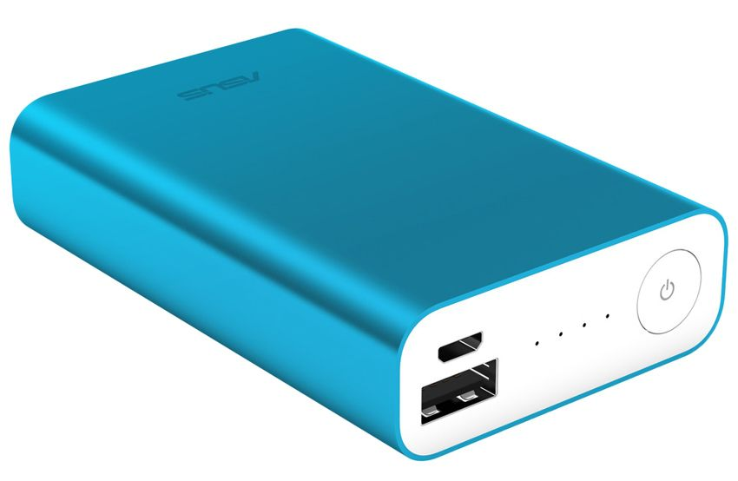
Main Plan
Lithium-Polymer & Lithium Ion
Li-Po Battery (n.d) Retrieved from www.motionrc.com/products/admiral-3300mah
Li-Ion Powerbank (n.d) Retrieved from www.snapdeal.com/product/asus-blue-zen-power-bank
PITECH

Slide 55
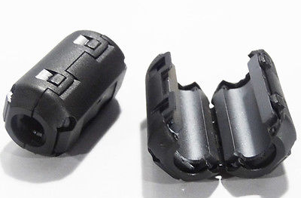
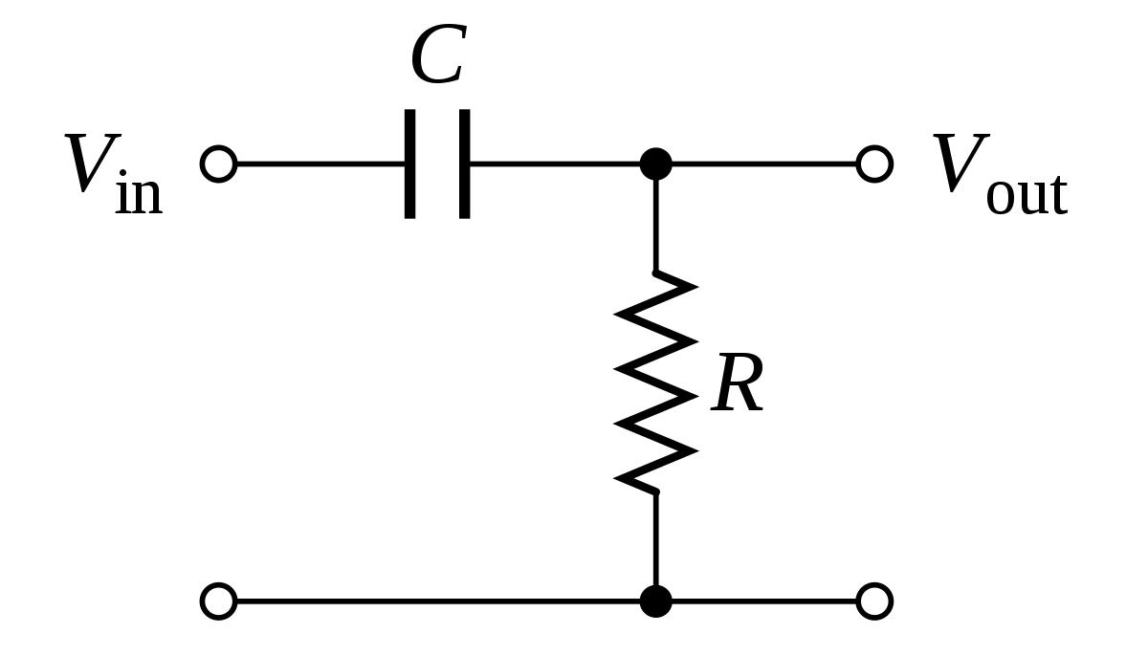
Backup Plan
Isolation Methods:
Capacitor connection to motor terminals
Choke Ferrite
Short twisted motor cables
High Pass filter for supply
Diode connections
Choke Ferrite (n.d.) retrieved from
picclick.com/5pcs-7mm-Noise-Suppressor
VDD
supply
VDD motor
Gnd
High Pass filter
PITECH

Slide 56

COO İREM COŞKUN
PITECH

Slide 57
Cost Analysis
Time Plan
Deliverables
Conclusion
PITECH

Slide 58
Cost Analysis
Materials | Number | Price per each | Total Price
Clone Arduino Uno | 1 | $5 | $5
Raspberry Pi 3 | 1 | $40 | $40
DC Motors | 2 +1 | $10 / $5 | $25
Gearbox | 3 | $5 | $15
Cables & Connectors | nAn | $6 | $6
Battery | 2 | $15 | $30
Dummy Robot | 1 | $2 | $2
Balls | 2 | $0.25 | $0.5
Chassis | 1 | $10 | $10
Encoders | 2 | $5 | $10
Play Field Walls | 3 | $1 | $3
3D Printed Parts | nAn | $8 | $8
FPV Drone Kit | 1 | $35 | $35
Wheels (Standard + Ball) | 2 + 2 | $2 / $1 | $6
Sum : $195.5
PITECH

Slide 59
Time Plan
Business Statement
Project Evaluation
Demonstration phase I
Conceptual design
Sep ‘18
Oct ‘18
Nov ‘18
Dec ‘18
Today
Company Foundation
Research
Brainstorming
Initial solution approaches
Tests
PITECH

Slide 60
Future Plans
DEMO
DAY
Shooting subsystem implementation
Testing Equipment
Testing overall system
Jan ‘19
Feb ‘19
Mar ‘19
Apr ‘19
May ‘19
Motion subsystem implementation
Testing individual subsystems
Implementation of Overall System
Final Tests
PITECH

Slide 61

Deliverables
Gallery For > Box Wallpapers. (2018). Retrieved from http://feelgrafix.com/data_images/out/28/984471-box.jpg
PITECH

Slide 62
Deliverables
01
Main Unit
PITECH

Slide 63
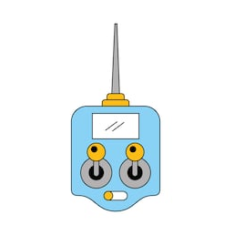
Deliverables
01
Main Unit
02
Communication Module
remote control antenna drone technology wireless. (2018). Retrieved from
https://www.shutterstock.com/image-vector/remote-control-antenna-drone-technology-wireless-759977725
PITECH

Slide 64
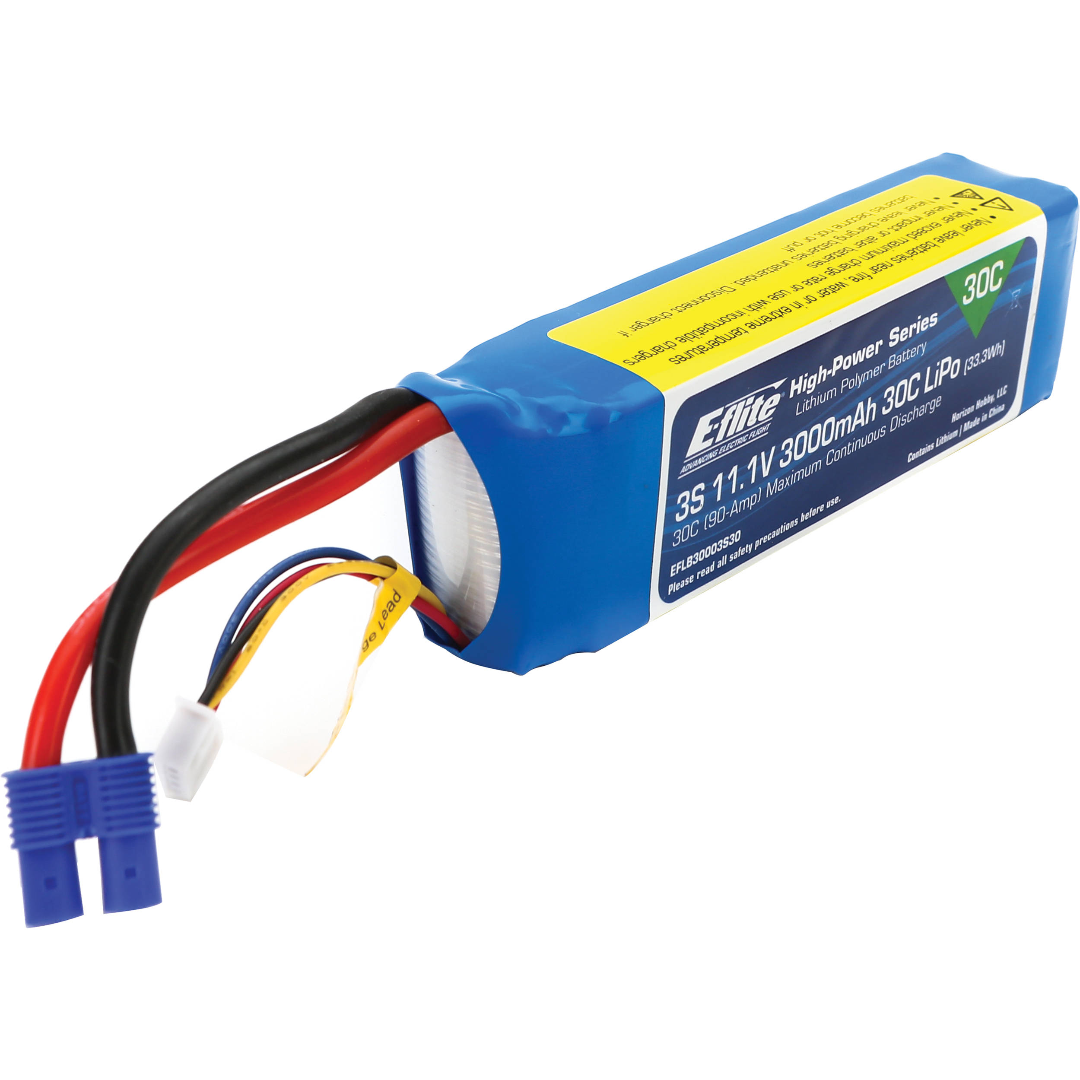
Deliverables
01
Main Unit
02
Communication Module
remote control antenna drone technology wireless. (2018). Retrieved from
https://www.shutterstock.com/image-vector/remote-control-antenna-drone-technology-wireless-759977725
03
Batteries
E-flite3000mAh 3S 11.1V 30C LiPo Battery for RC Aircraft. (2018). Retrieved from https://www.bhphotovideo.com/c/product/1127413-REG/e_flite_eflb30003s30_3000mah_3s_11_1v_30c.html
PITECH

Slide 65
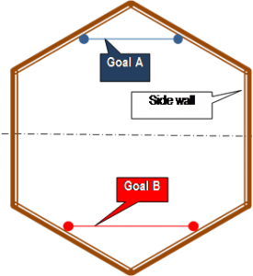

Deliverables
04
Game Field & A Ball
Projects – Capstone Design. (2018). Retrieved
from http://capstone.eee.metu.edu.tr/projects/
PITECH

Slide 66
Deliverables
04
Game Field & A Ball
Projects – Capstone Design. (2018). Retrieved
from http://capstone.eee.metu.edu.tr/projects/
05
A Dummy Robot
PITECH

Slide 67

Deliverables
04
Game Field & A Ball
Projects – Capstone Design. (2018). Retrieved
from http://capstone.eee.metu.edu.tr/projects/
05
A Dummy Robot
06
User Guide & Warranty Certificate
Phone | Blue Ridge. (2018). Retrieved from http://www.brctv.com/phone
PITECH

Slide 68
Conclusion
PITECH

Slide 69
Conclusion
Company Profile
PITECH

Slide 70
Conclusion
Company Profile
Problem Statement
PITECH

Slide 71
Conclusion
Company Profile
Problem Statement
Objectives
PITECH

Slide 72
Conclusion
Company Profile
Problem Statement
Objectives
Solution Aproaches on Subsystems
PITECH

Slide 73
Conclusion
Company Profile
Problem Statement
Objectives
Solution Aproaches on Subsystems
Proof of Concept
PITECH

Slide 74
Conclusion
Company Profile
Problem Statement
Objectives
Solution Aproaches on Subsystems
Proof of Concept
Plans
PITECH

Slide 75
References
Gallery For > Box Wallpapers. (2018). Retrieved from http://feelgrafix.com/data_images/out/28/984471-box.jpg
E-flite3000mAh 3S 11.1V 30C LiPo Battery for RC Aircraft. (2018). Retrieved from https://www.bhphotovideo.com/c/product/1127413-REG/e_flite_eflb30003s30_3000mah_3s_11_1v_30c.html
remote control antenna drone technology wireless. (2018). Retrieved from https://www.shutterstock.com/image-vector/remote-control-antenna-drone-technology-wireless-759977725
Projects – Capstone Design. (2018). Retrieved from http://capstone.eee.metu.edu.tr/projects/
Phone | Blue Ridge. (2018). Retrieved from http://www.brctv.com/phone
AKK KC03 FPV Camera with 600MW Transmitter (n.d.). Retrieved from https://www.akktek.com/akk-kc03.html
Li-Po Battery (n.d) Retrieved from www.motionrc.com/products/admiral-3300mah
Li-Ion Powerbank (n.d) Retrieved from www.snapdeal.com/product/asus-blue-zen-power-bank
PITECH

Slide 76

PITECH

Slide 77
Contact Us
potatointegrated@gmail.com
1427.Cadde İşçi Blokları Mah. 10. Yıldız Blok No: 35/23 A
Çankaya/Ankara
linkedin.com/potatointegrated
facebook.com/PITECH
PITECH

